Slide 1
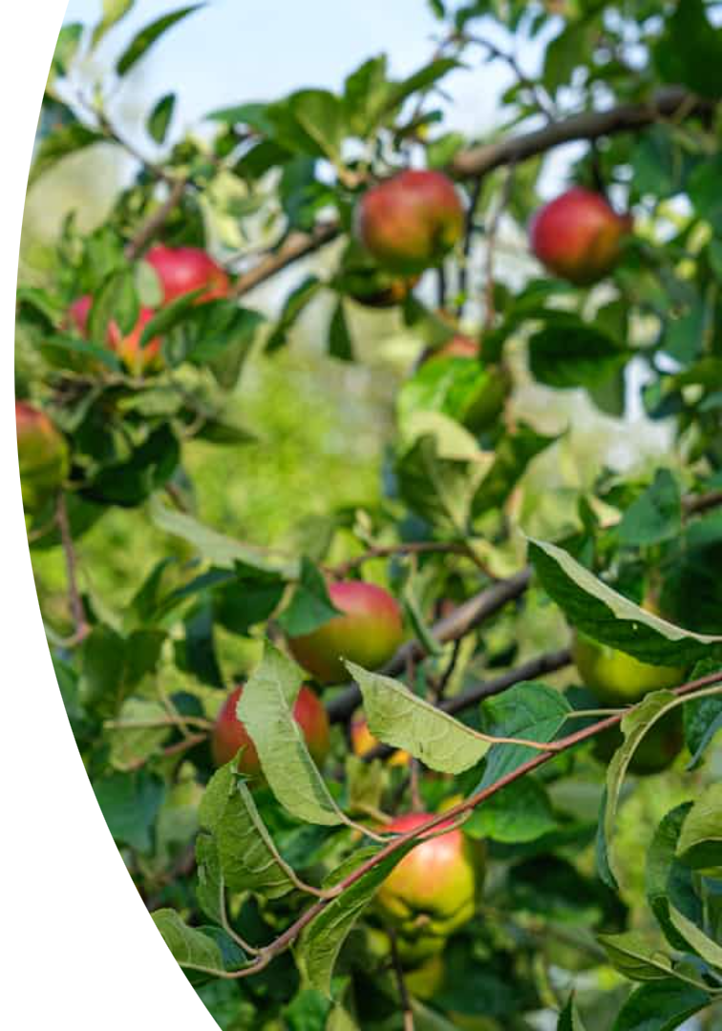
Binary Classification of Apple-Leaf Diseases
Group 6: Shaheryar & Feruz • NCML 2025

Slide 2




Why It Matters
Disease Impact
Manual Limitations
Reduces yield and quality.
Slow and subjective inspection.
Our Objective
Fast, binary "Healthy vs Diseased" prediction.

Slide 3
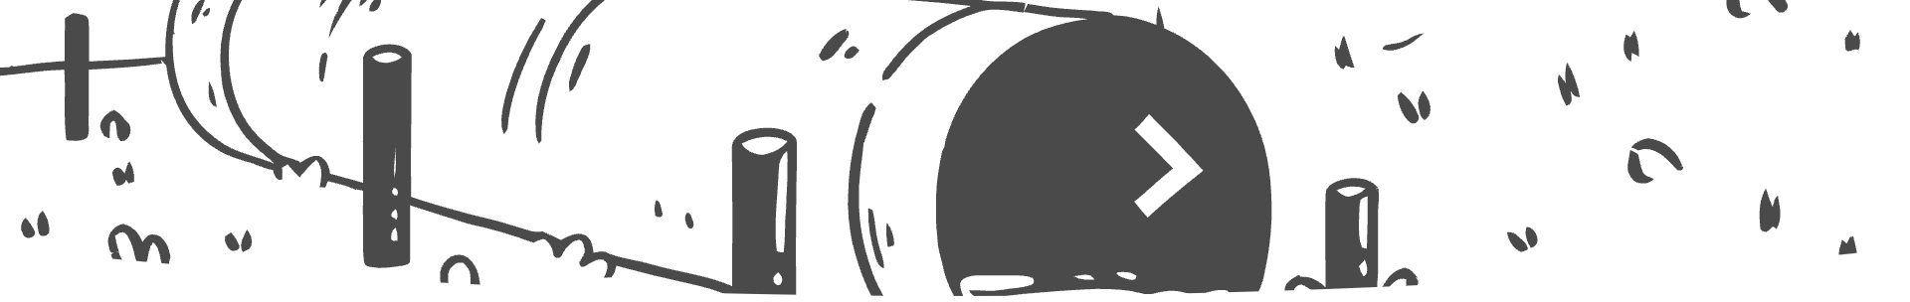




Dataset Pipeline
Data Source
PlantVillage: 50k images, 35 classes.
Filtering & Merging
Apple leaves only; Rust + Powdery → "Diseased."
Splitting
70% train, 15% validation, 15% test.
Imbalance Handling
Augmentation for 864 Diseased vs. 458 Healthy.

Slide 4

Baseline Attempts
Logistic Regression
K-Means Clustering
44% accuracy on pixels.
NMI 0.67 on CNN embeddings, weak clusters.
Single-head Multi-class CNN
94% accuracy, but overkill for binary.

Slide 5
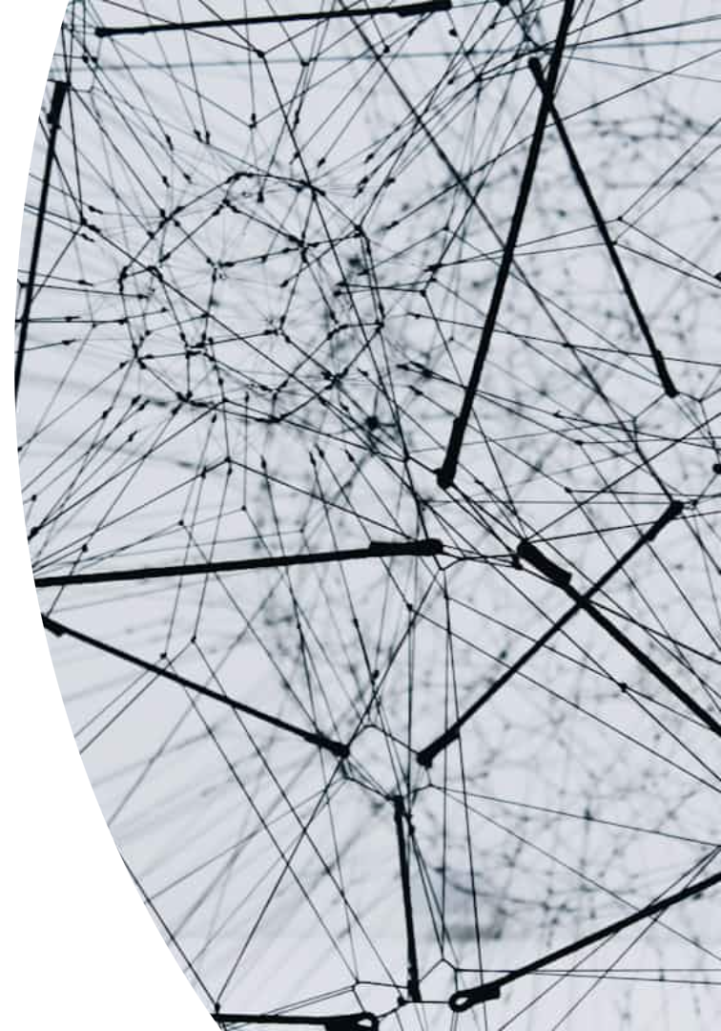
Final Model Architecture
Base Model
ResNet-18 pretrained on ImageNet.
Output Layer
Replaced with 1 logit (sigmoid).
Training Configuration
Loss: BCEWithLogits; Optimizer: Adam 1e-4.
Execution
5 epochs on Tesla T4, batch size 32. Code on GitHub.

Slide 6
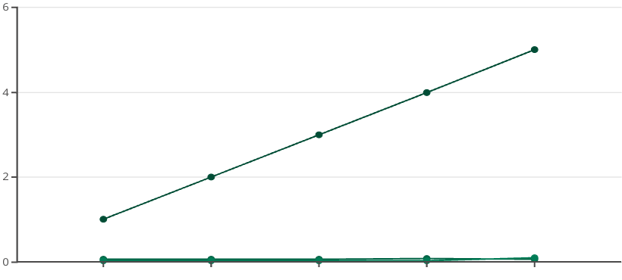
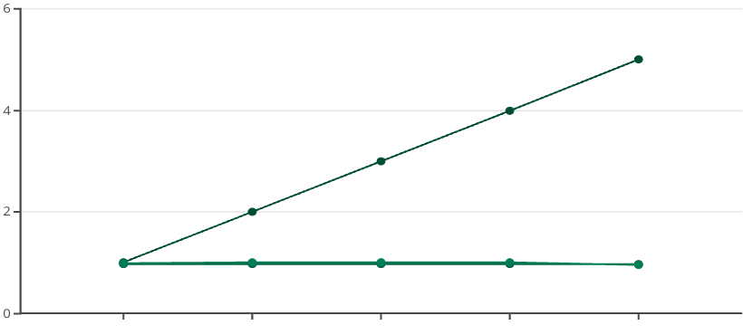
Training Progress – 5 Epochs
Loss Over Epochs
Accuracy Over Epochs
Epoch
Train Loss
Validation Loss
Epoch
Train Accuracy
Validation Accuracy
Loss and accuracy trends for training vs. validation over five epochs.

Slide 7
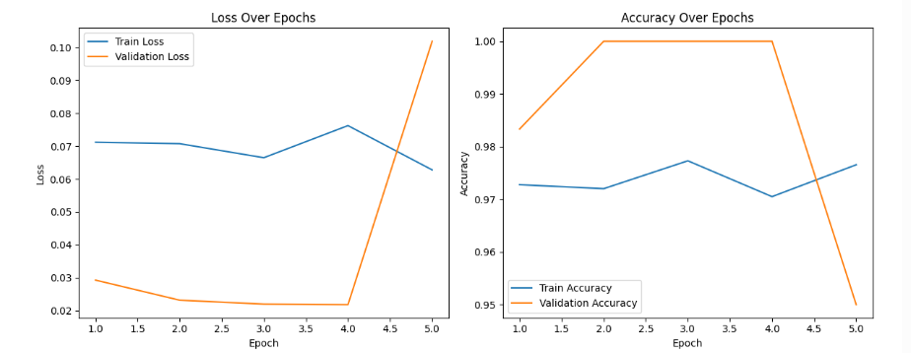
Training Progress – 5 Epochs
Loss Over Epochs
Accuracy Over Epochs
Epoch
Train Loss
Validation Loss
Epoch
Train Accuracy
Loss and accuracy trends for training vs. validation over five epochs.

Slide 8
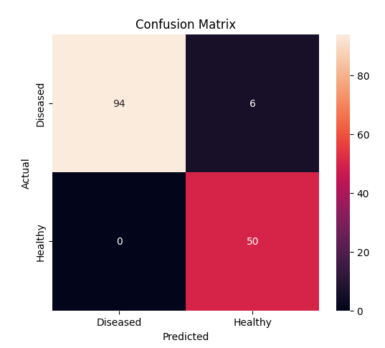
Test-Set Results
Overall Accuracy
Healthy Recall
96%
100%
Diseased Recall
94%

Slide 9
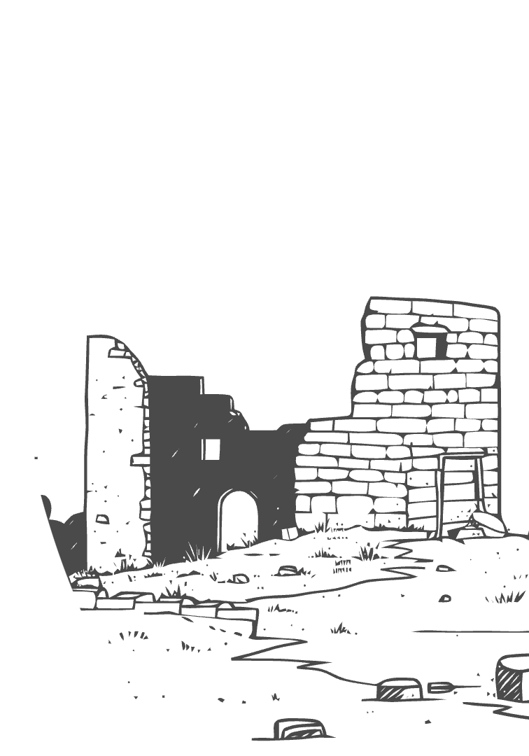
Abandoned Ideas & Lessons
Attempt
Why Dropped
MLP Baseline
No spatial features
K-Means
Poor separation
Single-head CNN
Unnecessary classes
Two-head CNN
99% val but poor generalization
UMAP plot shows nice species clusters, implying the model learned, but some approaches were over-engineered.

Slide 10
Reasoning Behind Our Dataset Change
Original dataset (PlantVillage) contains 50,000+ images across 38+ classes and species.
We simplified the task to focus only on Apple leaves labeled as either Healthy or Diseased
Reduces ambiguity (we don’t mix up symptoms across species)
Aligned with practical applications, such as early-stage disease screening, where speciescontext may already be known

Slide 11




Limitations & Next Steps
Dataset Size
Overfitting
Small dataset with mild class imbalance.
Observed after 4-5 epochs.
Future Work
Multi-disease labels, MobileNet deployment, SHAP/LIME explanations.

Slide 12
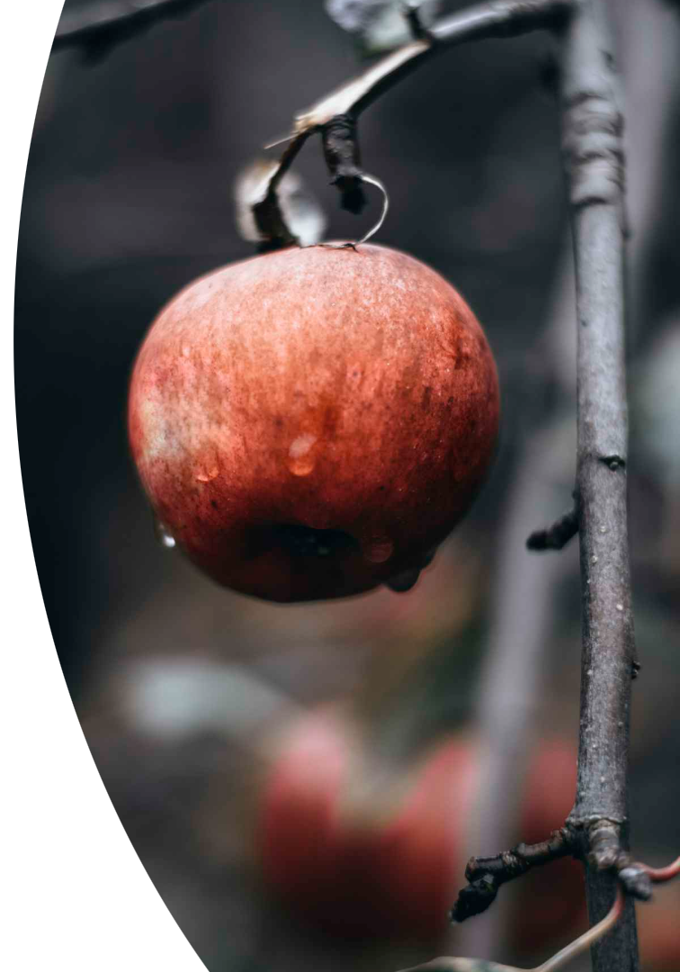
Take-Home Message
A lightweight, transfer-learned ResNet achieves 96% accuracy on apple-leaf health with ~1k images. This provides a practical early-warning tool for orchards.
Live demo of earlier prototype: https://plantdiseasencml.vercel.app/

